Slide 1
The Assignment
You have been tasked with getting requirements together to deliver a module within the existing system, which will provide a rich feature set for those practices with an animal hospital forming part of their practice activities.
As an agile business analyst, how would you go about getting requirements together for this hospital module and how you would feed them into the agile development process.

Slide 2


Paws-itively Agile: Gathering Requirements for Telemedicine Feature Integration.
Presented By: David Lawrence

Slide 3


Introduction
Feature Brief:
The proposed Telemedicine Integration feature will represent a significant leap forward in our software development offerings. By seamlessly incorporating telemedicine capabilities into VetIT's existing practice management system, we will revolutionize the way Vet Care is delivered.
This integration will empower veterinary practices to transcend the limitations of traditional clinic settings, offering pet owners the convenience of remote consultations and access to patient records from anywhere, at any time.
Need for the Feature:
In today's digital age, the demand for telemedicine in veterinary care is on the rise. Pet owners seek convenient and accessible healthcare options for their furry companions, especially in situations where in-person visits are challenging or impractical.
The integration of telemedicine functionality addresses this need by providing veterinarians with the tools to offer remote consultations, monitor patient health remotely, and maintain continuity of care.
Some Benefits:
Enhanced Service Portfolio: The introduction of telemedicine capabilities will expand VetIT's service portfolio, attracting new clients and increasing client retention by offering modern, convenient healthcare options.
Competitive Differentiation: The Telemedicine Integration feature will differentiate VetIT from competitors, showcasing our commitment to innovation and our ability to deliver forward-thinking solutions that exceed client expectations.

Slide 4

Understanding the Problem Space
Stakeholder identification: Identify key stakeholders like veterinarians, hospital staff, practice managers, Specialists, IT personnel, and existing customers.
Stakeholder interviews: Conduct interviews to understand their roles, workflows, pain points and how the Telemedicine would address their needs.
Facilitate Workshops: Organize workshops or focus groups to encourage collaboration among stakeholders. I will use brainstorming techniques to generate ideas and prioritize features based on importance and technical feasibility.
Assessment of System Compatibility: Evaluate the current PMS system to assess it's compatibility with Telemedicine Integration. Identify any technical limitations that may impact the integration process.

Slide 5

Stakeholder Management
Stakeholder Analysis (RACI, Power & Influence Matrix): Assess influence, interests, and potential impact of each stakeholder group.
Communication Plan: Devise a communication strategy for effective engagement and managing stakeholder expectations. Communication Channel, Frequency of Communication, Content of Communication.
Change Management (ADKAR): Plan for addressing resistance and facilitating smooth adoption of the new module. Provide clear explanations of the benefits of telemedicine, offer training and support to stakeholders, and address any misconceptions or concerns.

Slide 6
Requirement Gathering
Requirement Engineering: Elicit and gather requirements, leveraging on different requirement gathering techniques( Interviews, Workshops, Focus Group and also review existing veterinary policy document etc). Analyse and categorize the requirements into Functional (e.g Video Consultation, Medical Record Sharing) and Non-Functional Requirements (e.g Security, Scalability) to ensure the platform meets technical and operational criteria.
User Stories: Work closely with veterinary staff, hospital administrators, and other stakeholders to capture user requirements in the form of simple, informal user stories, ensuring that the stories describe the desired functionality from an end-user perspective.
Process Modeling: Use techniques like flowcharts, swim lane diagrams to visually represent the workflows and interactions involved in the Telemedicine Platform.
Prototyping: Create low-fidelity prototype wireframes to visualize the proposed solution. Validate the prototypes with stakeholders to ensure they accurately represent their requirements and expectations.
Prioritization: Prioritize requirements leveraging MoSCoW technique and also based on business value, technical feasibility, and dependencies.
Acceptance Criteria: Define clear acceptance criteria for each user story following the Gherkin Syntax
Use Case Diagram: Create a use diagram that will identify the primary and secondary actors. The use case diagram will provide a high-level illustration of the main interactions and functionalities of the Telemedicine feature from the perspective of the primary user, the veterinarian.

Slide 7
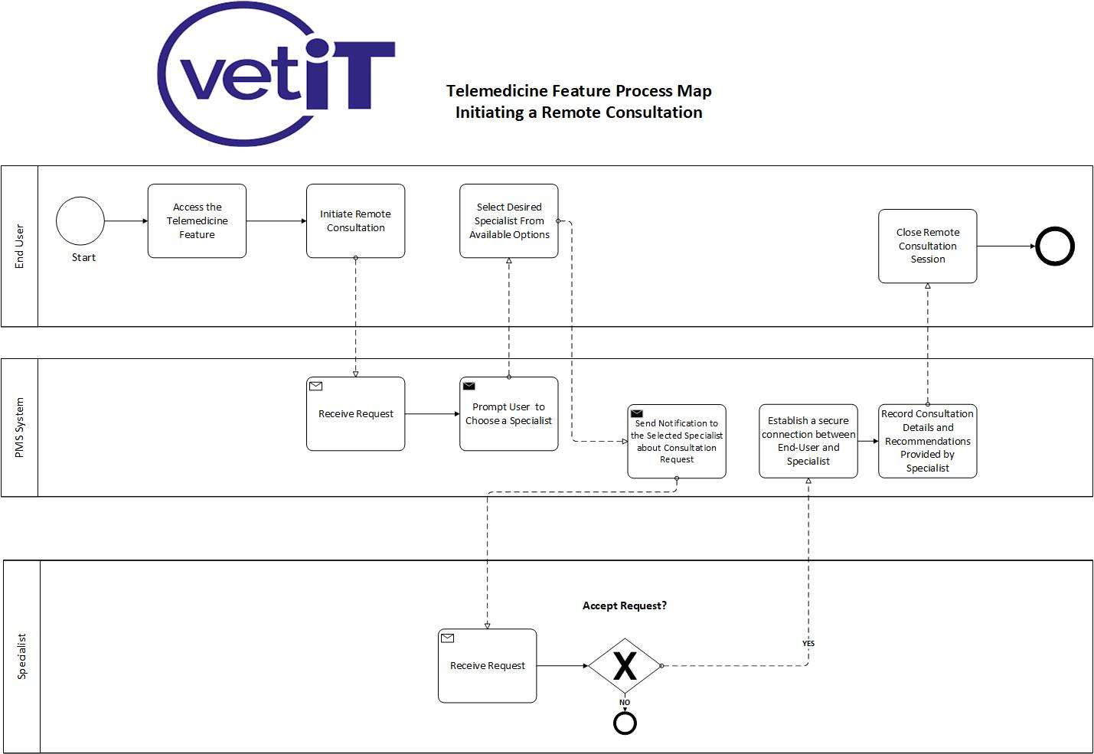

Slide 8

User stories and their corresponding Acceptance Criteria for the Integrated Telemedicine Feature:
User Story 1: Initiating Remote Consultation
As a veterinarian, I want to initiate a remote consultation with a specialist,
so that I can discuss complex cases.
Acceptance Criteria:
Scenario 1:
Given that I am logged into the telemedicine platform,
When I select the option to initiate a remote consultation,
Then the platform should display a list of available specialists.
Scenario 2:
Given that I select a specialist for consultation,
When I schedule an appointment or request an on-demand consultation,
Then the platform should confirm the appointment and notify the specialist.
Scenario 3:
Given that the appointment is confirmed,
When the scheduled time arrives,
Then the platform should facilitate a secure video conference session between me and the specialist.

Slide 9
User stories and their corresponding Acceptance Criteria for the Integrated Telemedicine Feature:
User Story 2: Accessing Patient Records during Consultation:
As a specialist, I want to access patient records during a remote consultation,
so that I can provide informed recommendations.
Acceptance Criteria:
Scenario 1:
Given that I am in a remote consultation session,
When I access the patient's profile,
Then the platform should display comprehensive medical records, including past treatments and diagnostic results.
Scenario 2:
Given that I review the patient's medical history,
When I request additional information or documents,
Then the platform should allow the veterinarian to share relevant documents securely.
Scenario 3:
Given that the consultation is concluded,
When I add my recommendations or notes to the patient's record,
Then the platform should save the updates and notify the veterinarian of any changes.

Slide 10
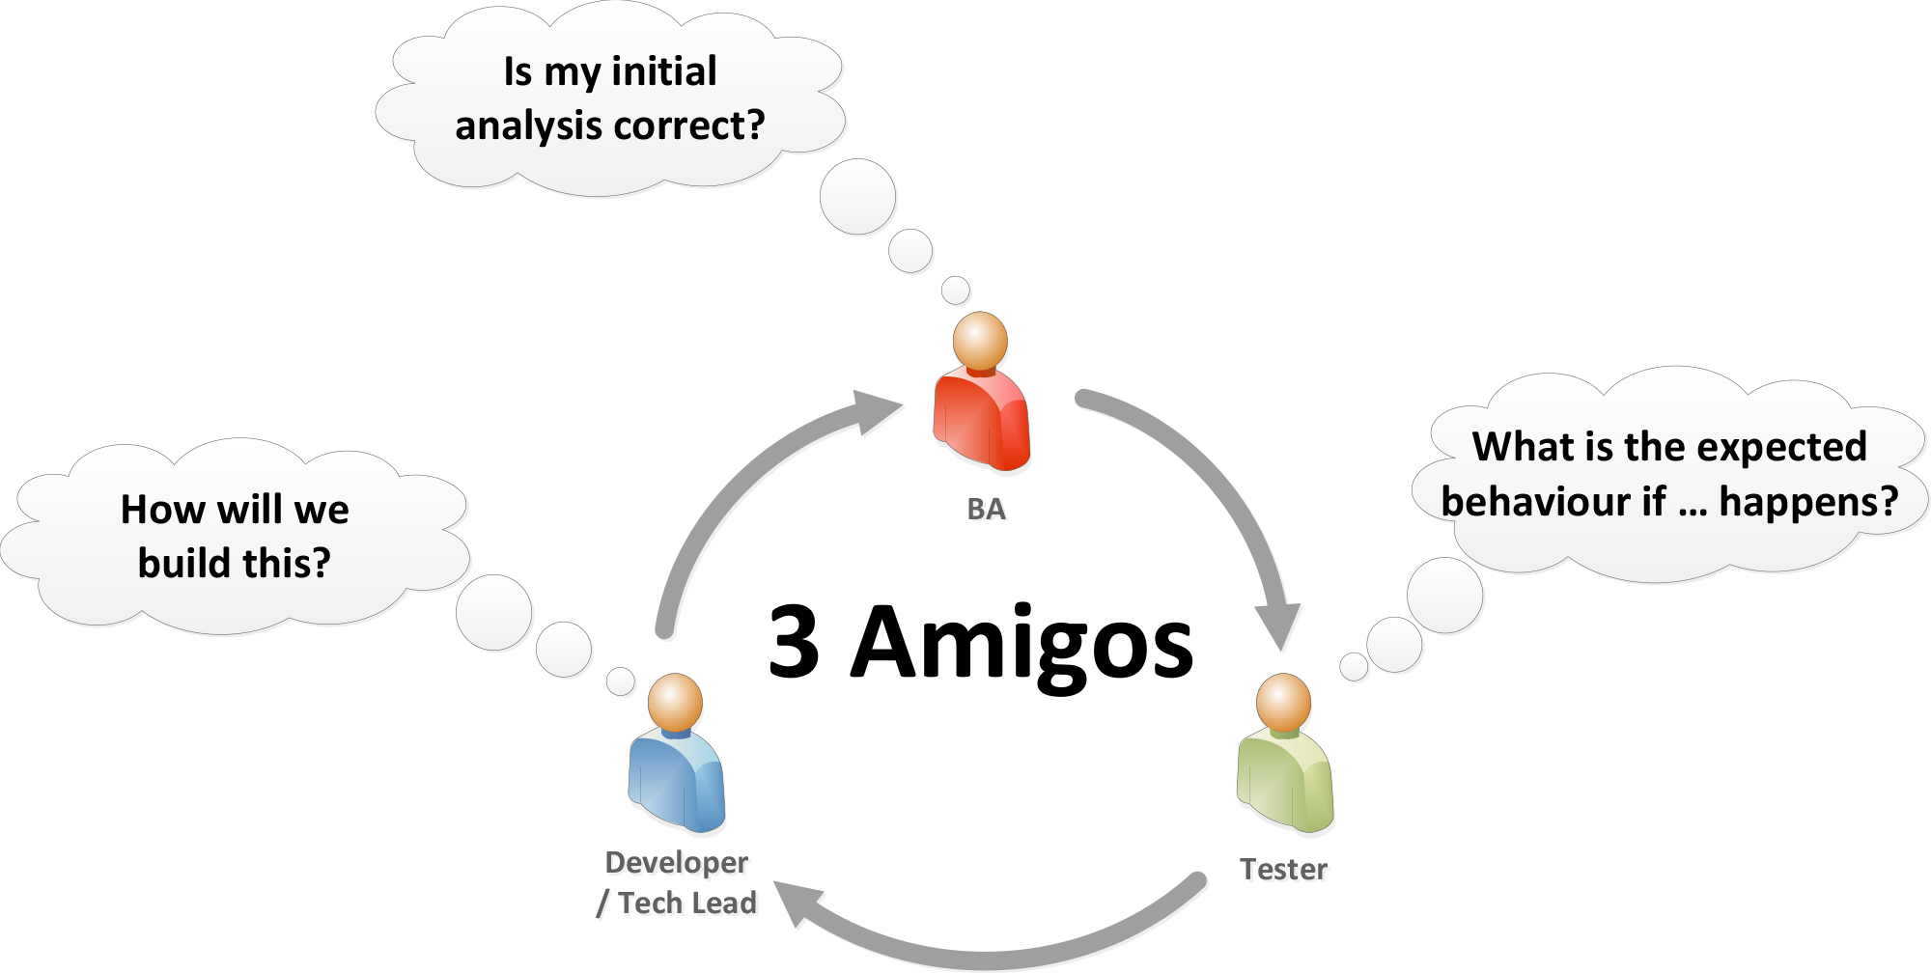
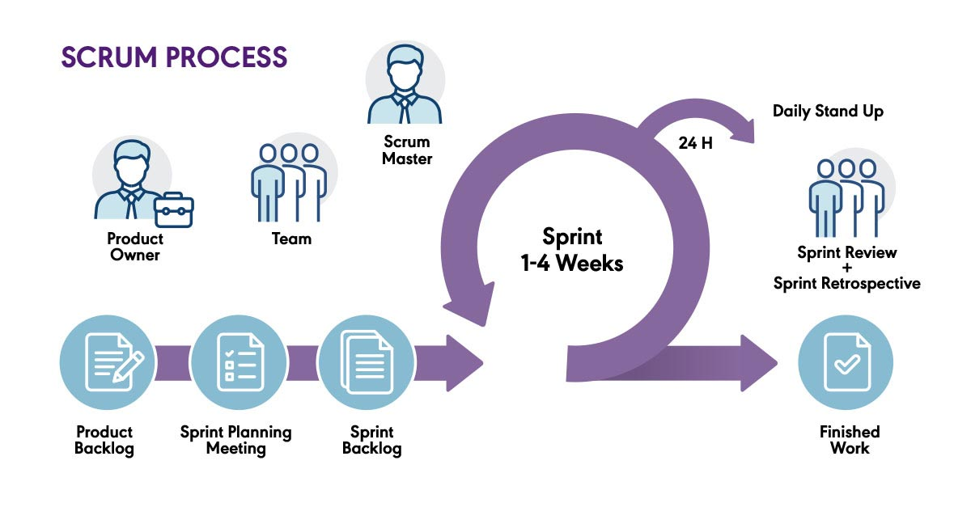
Agile Development Integration
Agile Development Integration
Development Director
Dev
Team
Story Refinement & Estimation

Slide 11
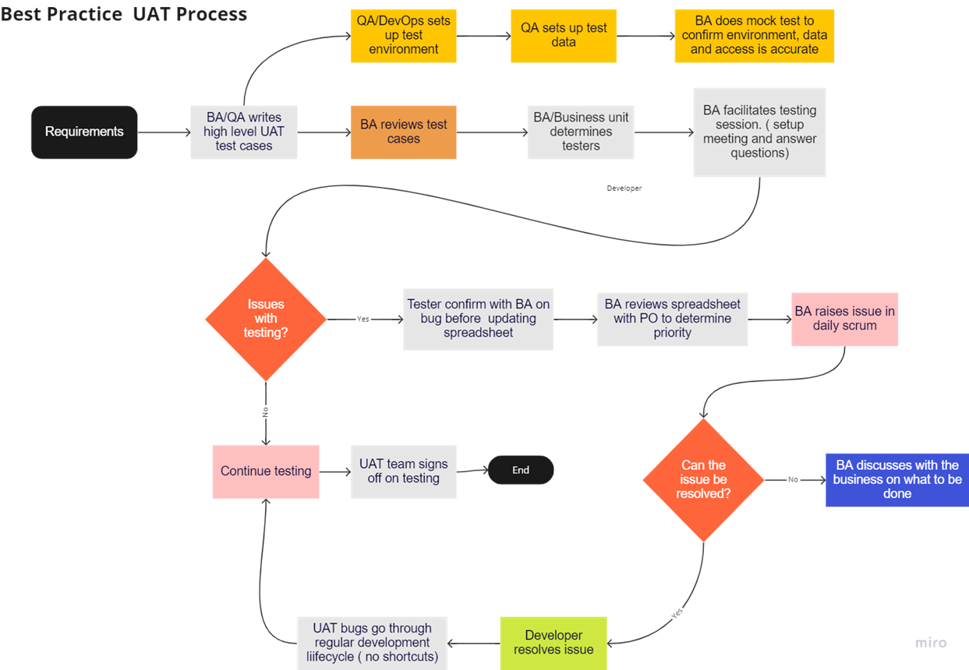
UAT Testing
New-Assigned-Open-Fixed-Retest-Verified-Close

Slide 12

Conflict Management
In the event of disagreements among stakeholders during the implementation of the telemedicine feature, my approach to managing this conflict will be proactive and collaborative.
For Example, a disagreement can occur between the Marketing Manager who is eager to launch the Telemedicine feature as soon as possible to capitalize on market demand, And the Development Director who emphasizes on thorough testing that may result in a longer development time-line.
My approach will be to;
Facilitate an open and collaborative with both stakeholders to understand each stakeholder's perspective.
Identify common goals which is delivering a successful product that meets customer needs and enhances VetIT's reputation.
Find a middle ground balancing timely delivery with product quality and user satisfaction.
By fostering open communication and collaboration, conflicts will be resolved constructively, ensuring project success

Slide 13
Measuring Impact and Continuous Improvement For Telemedicine Feature
Define Metrics: Set clear and measurable goals, such as increased remote consultations, reduction in patient wait time and revenue from telemedicine.
User Feedback: Gather insights through surveys, interviews, or focus groups to understand usability and effectiveness.
Adoption Monitoring: Track user adoptionwith metrics like active users and usage frequency.
Feedback Channels: Establish mechanisms for continuous input to identify improvement areas.
Continuous Improvement: Iterate based on feedback to optimize performance and value incrementally.

Slide 14

Q&A

